Slide 1

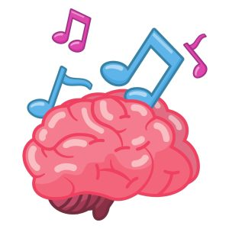
How music impacts mental health from a set of listening attributes.
Josh Cacayan

Slide 2
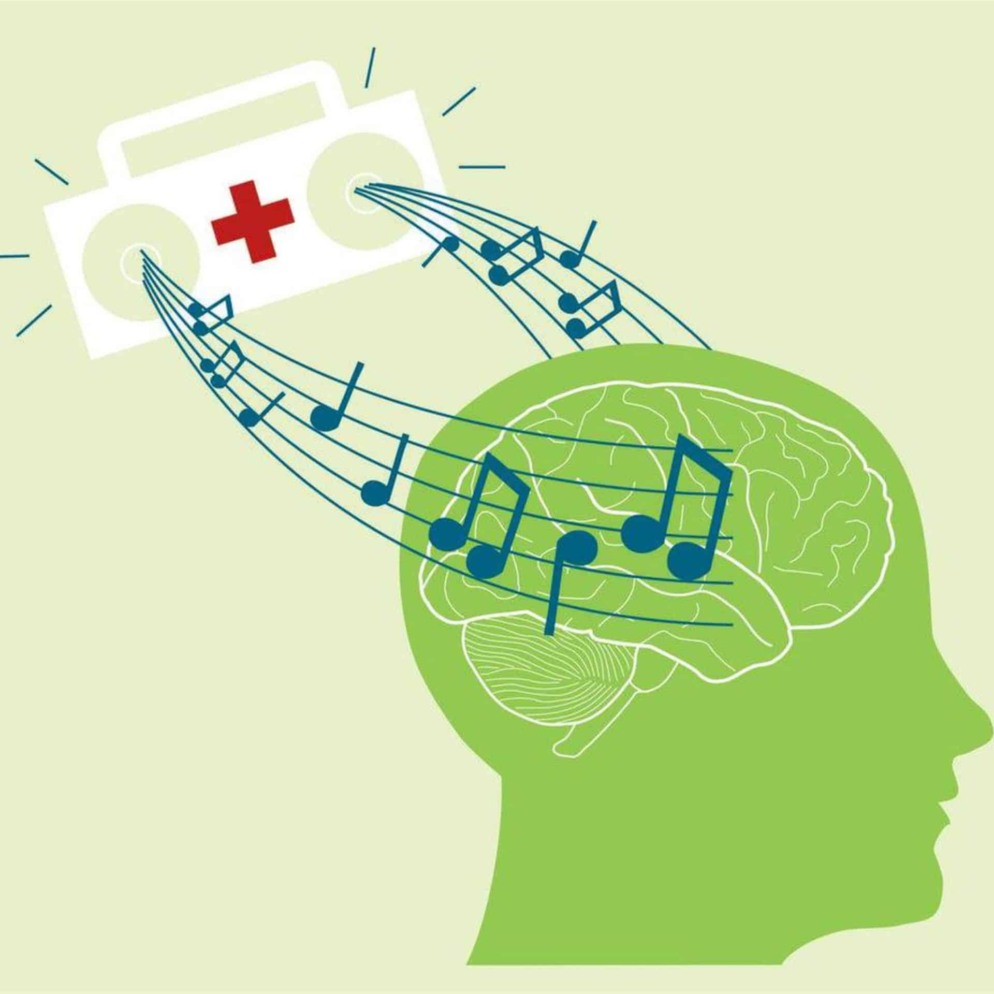
Why I wanted to study it / Intended Goals
I believed that the study that was used for the dataset was interesting, as one who listens to lots of music and likes psychology.
Does Music have any effect on mental health and can it be predicted? What factors contribute?
Data analysis has been done, however no Machine Learning Algorithms used

Slide 3
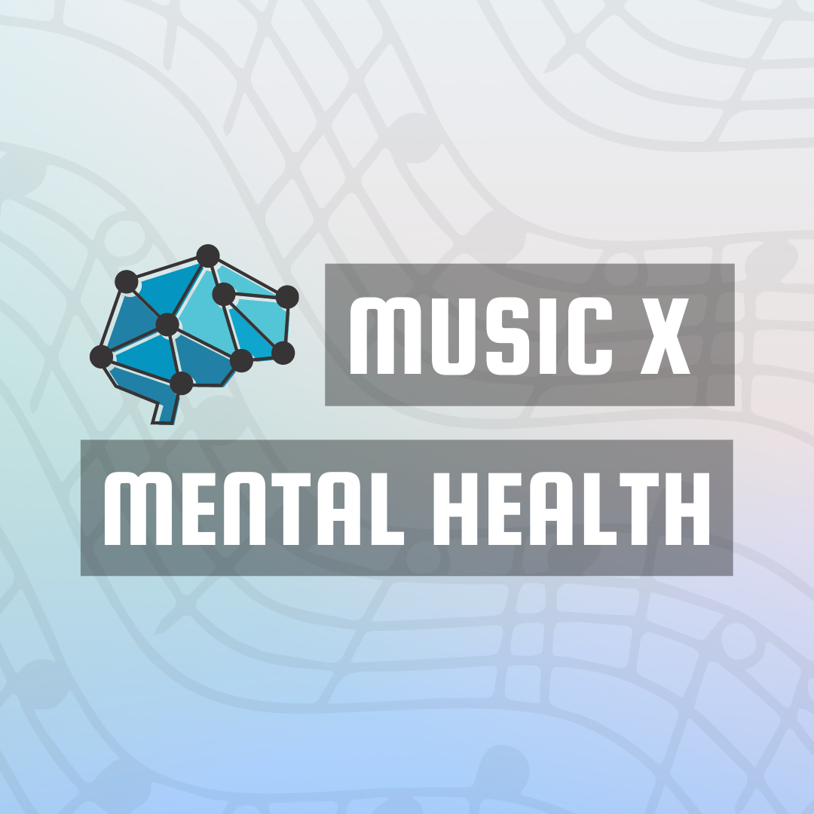

Dataset used
Music and Mental Health Survey Results
Found on kaggle.com!!
Music & Mental Health Survey Results

Slide 4


Cleaning the Data
Used excel to help clean the data
Removed rows where ‘music effects’ are not present
Removed Columns that were not useful (Timestamp, Primary Streaming, Permissions)
Autofilled a few null values such as some bpms, and age
Turned the excel file into an arff file

Slide 5
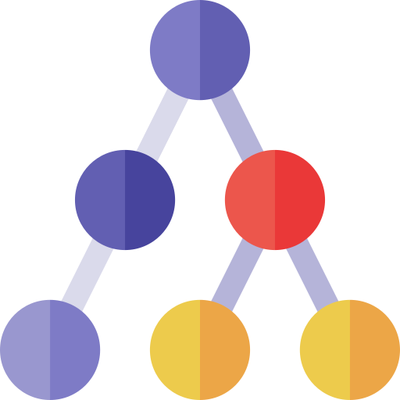
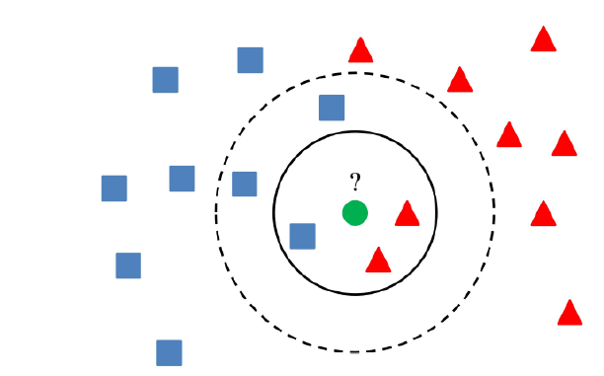
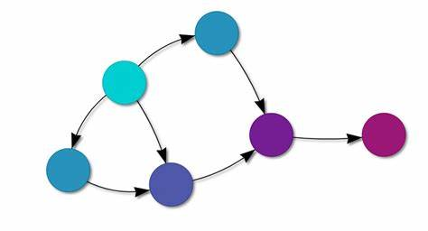
Machine Learning Algorithms
Used in previous assignments
Bayes Net Algorithm
J48 Decision Tree
One R Rule
Not used in previous assignments
SMO Function
Simple KNN Means

Slide 6
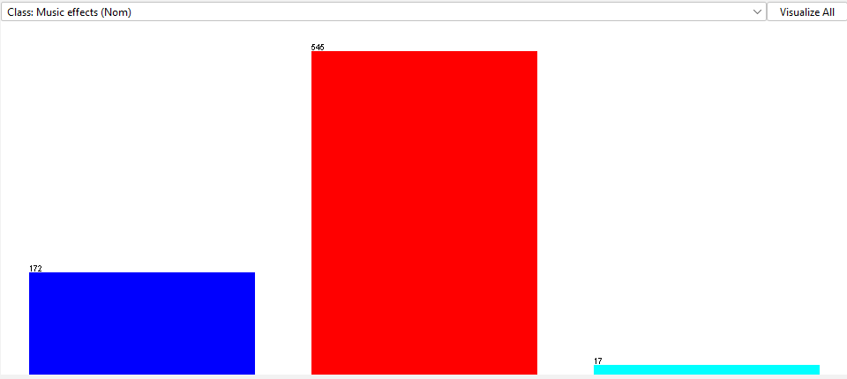
Attributes Used (Target)
Target Attribute: Music Effects
(Does music improve mental health)
Improve ( 545 instances)
No Effect (172 instances)
Worsen (17 instances)

Slide 7
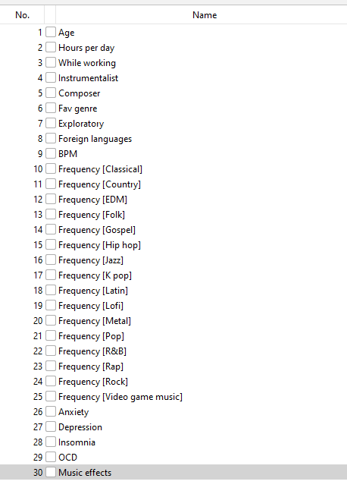
Attributes Used (Non-Target)
Age
Hours Per Day
While Working
Composer and Instrumentalist
Favorite Genre
BPM (Beats Per minute / Speed)
Frequency (Genres)
Mental Health
OCD
Depression
Insomnia
Anxiety

Slide 8
Findings weren’t great..

Slide 9
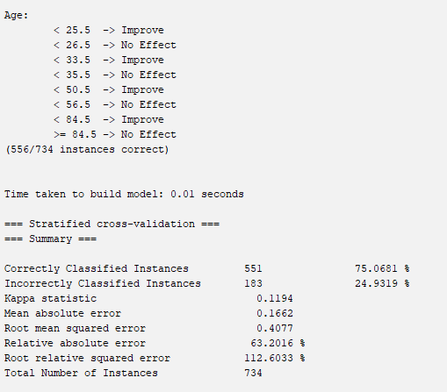
One-R Algorithm
Determines the most important attribute: Age
75% correct instances, 24% incorrect
Kappa Value: 0.11 (Slight)
This is considered a slight (bad) Model in Landis and Koch Terms

Slide 10
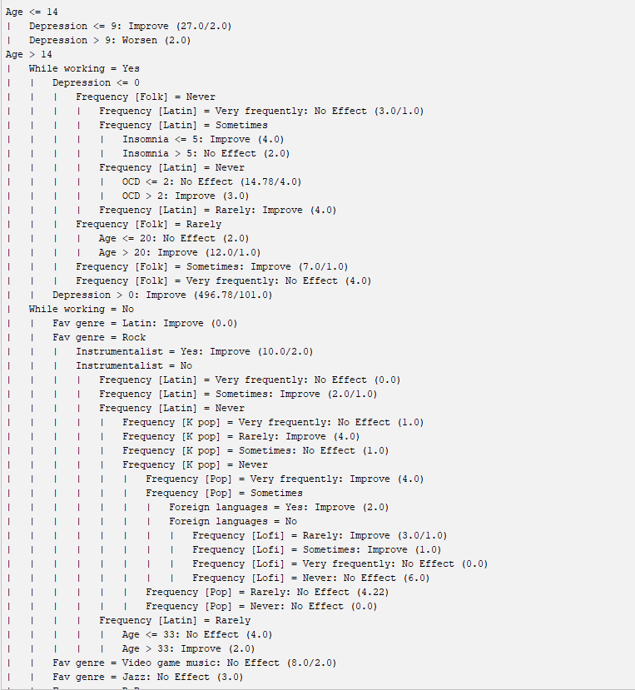
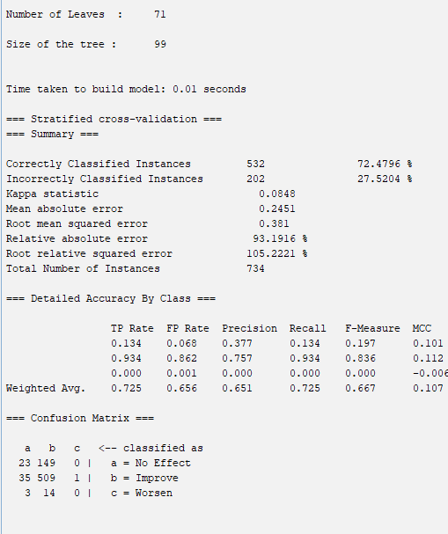
J48 Algorithm

Slide 11
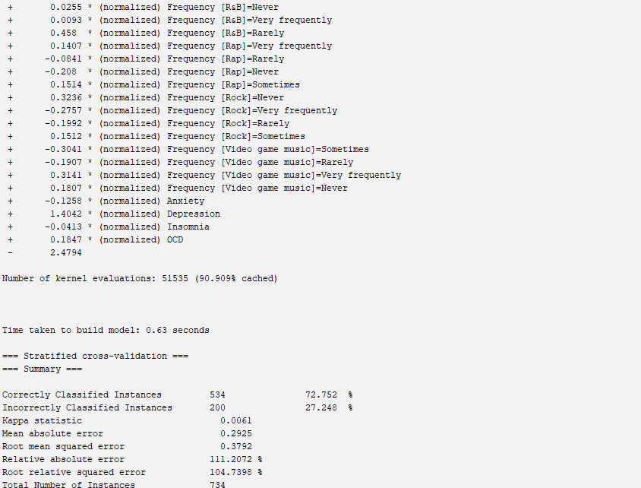
SMO (Support Vector Machine)
Classifies the target attribute (Music Effects) using a hyperplane to separate instances to classes based on distance
72% correct instances, 27% incorrect
Kappa Value: 0.0061 (Slight)
This is considered a slight (bad) Model in Landis and Koch Terms

Slide 12
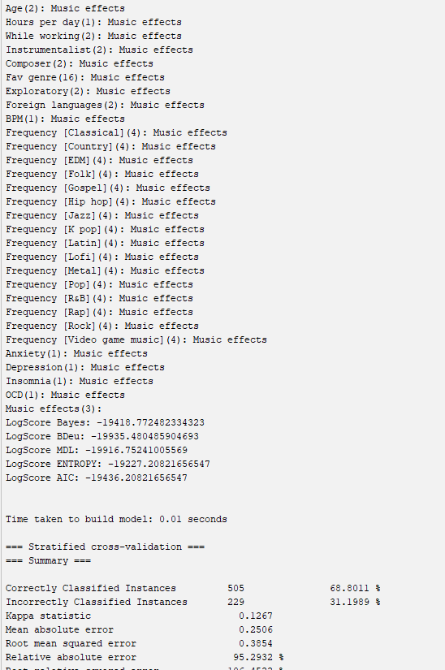
Bayes Net Algorithm
Algorithm that classifies how nontarget attributes relate to the target attribute by finding probabilities with bayes theorem.
68% correct instances, 31% incorrect instances
Kappa: 0.12% (Slight)
This is considered a slight (bad) Model in Landis and Koch Terms

Slide 13
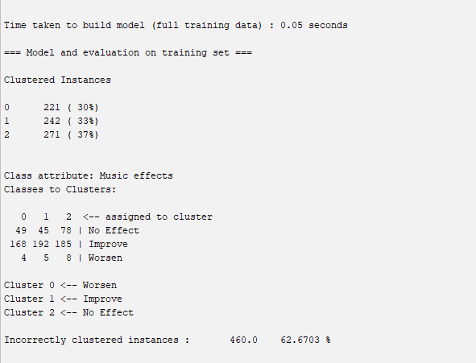
Simple K Means Algorithm
Categorized all instances to 3 classes:
Cluster 0: Improve Mental Health
Cluster 1: No Effect on Mental Health
Cluster 2: Worsen Mental Health
Clustered Instances
Improve Mental Health: 221 instances
No effect on Mental Health: 242 instances
Worsen Mental Health: 271 instances
Incorrect clustered instances: 62%!!! (Worse model yet)

Slide 14

What Went Wrong?

Slide 15
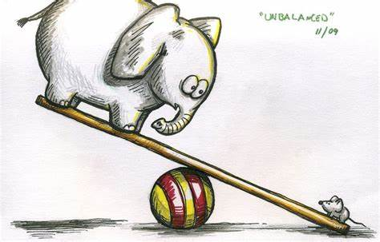

Possible Problems of the Dataset
Dataset was unbalanced, 74% of users say it would improve, 25% has no effect/worsens mental health
Vague in determining how it impacts a person's mental health
Dataset was made as a survey, with the statistician having no control of external factors (get a domain expert)

Slide 16
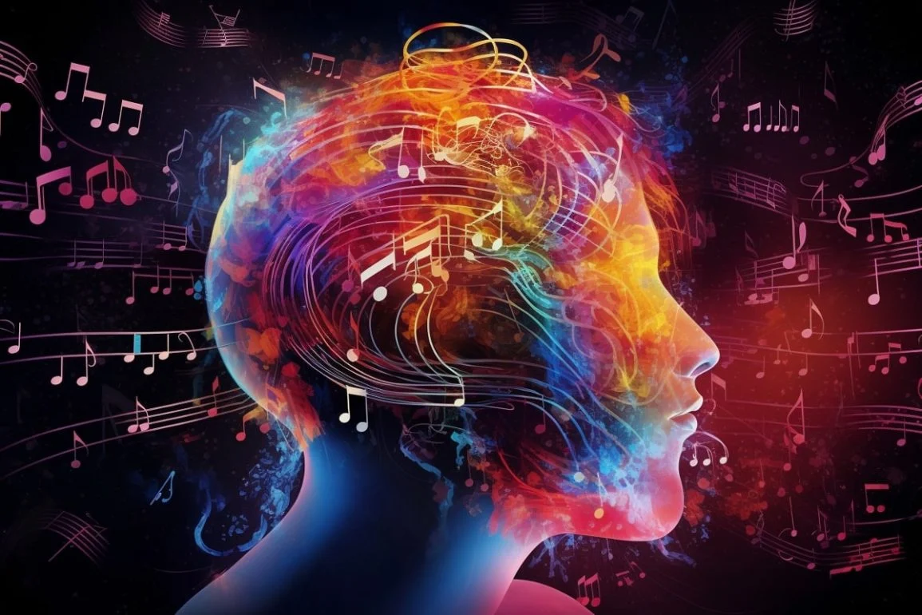
What can be taken away?
Most people that listen to music most likely will improve their mental health!
There are no specific attributes on what determines if music impacts mental health or not.
A dataset which was formed with a survey is not the greatest for classification analysis (Kappa values were low)
Survey should be specific on what mental health improvements entails
If it helps cope with their emotions
If the user listens to music while working does it help?

Slide 17
Any Questions?????

